Slide 1
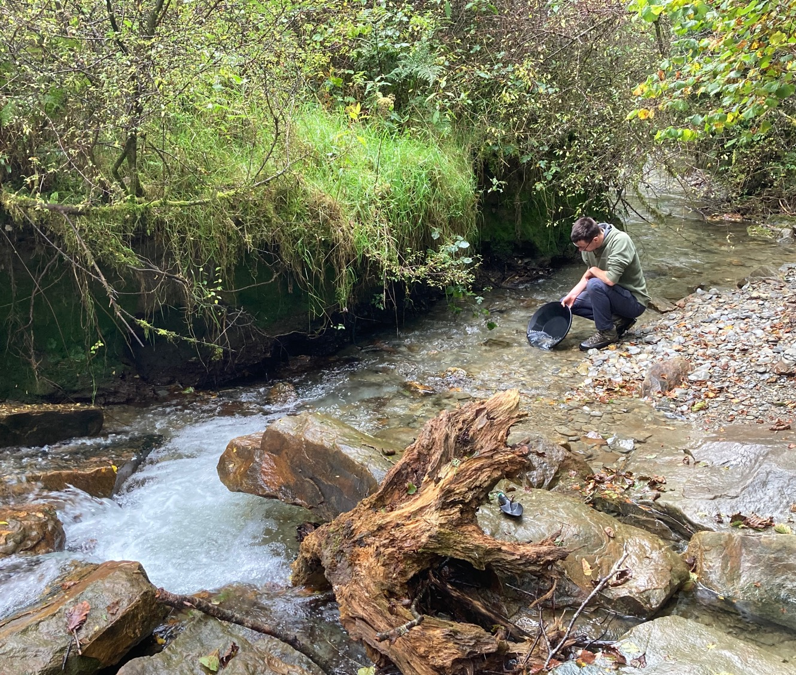
Sarn Helen Gold
A Welsh Gold Exploration Company
2023 marks the 100-year anniversary of the first time Welsh Gold was used to create a wedding ring for a member of the British Royal Family. No gold has however been mined in Wales this century

Slide 2
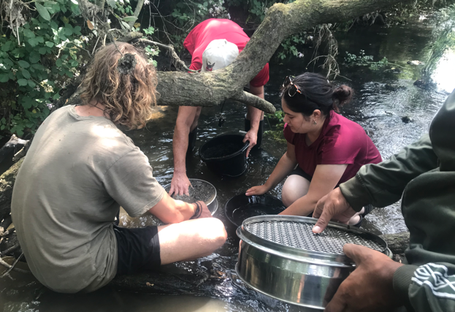
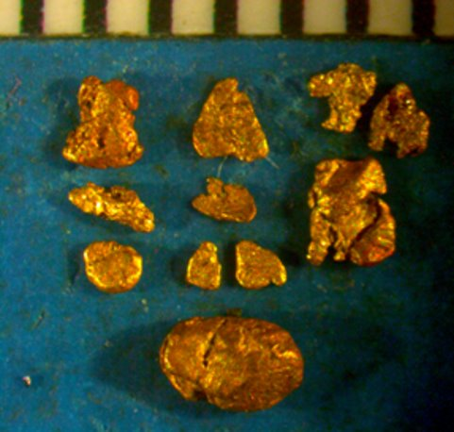
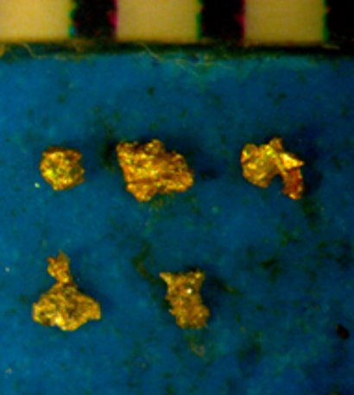
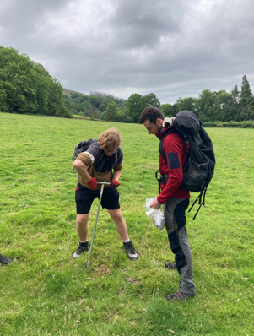
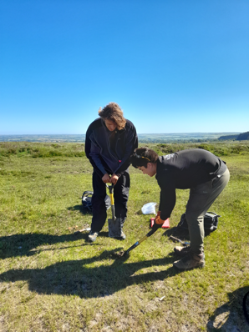
Sarn Helen Gold Vision
To locate, permit, and build the next gold mine in Wales
Preselis
.
Treffgarne
.

Slide 3
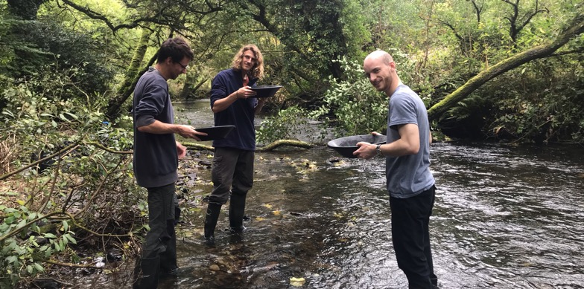
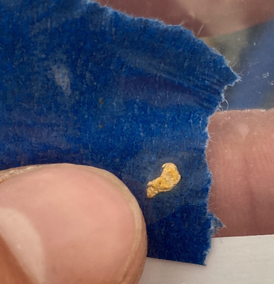
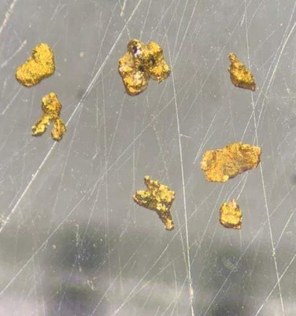
A Welsh Gold Exploration Company
Welsh team:
Board and management are either Welsh or live in Wales or both.
Field teams are geology students from Cardiff University
Local community benefits:
Keeping local community aware of and updated on our activities.
Ensuring the project benefits the local community through procurement of local services and potentially via employment opportunities.
Committing a portion of our exploration expenditure to a fund to be used to benefit the communities in which we explore.
Low Environmental impact:
Environmentally responsible - all field activities will be conducted with both the environment and local community in mind.
Current field activities are low impact, soil and stream sediment sampling undertaken with a leave no trace approach.
Any future mine would be underground with very low surface footprint. (Scotgold’s Cononish mine was permitted and is active in a National Park)

Slide 4
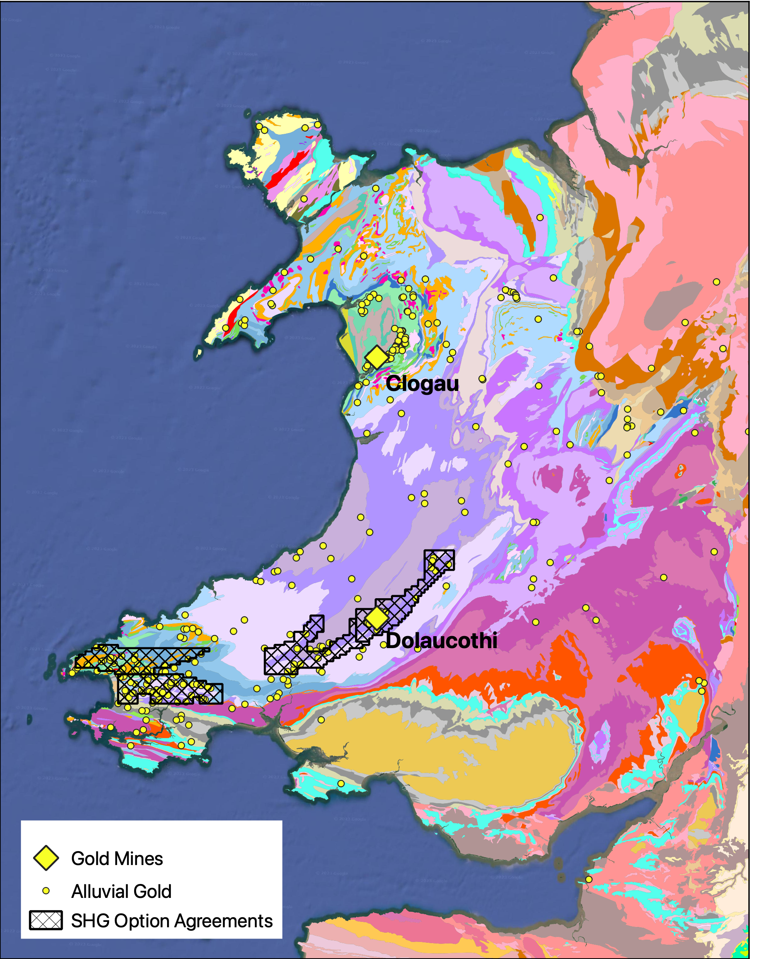
A Long History of Gold Mining in Wales
The Romans came to Wales for gold.
Dolaucothi was the only Roman gold mine in Britain.
Dolaucothi mined again in C 19th & C 20th and closed in 1939 (WWII). It was allowed to flood and never reopened – it didn’t run out of ore.
Clogau in N Wales discovered in C 19th closed in 1998
British Geological Survey shows alluvial gold in N & W Wales
  where did it all come from?
SHG focus on:
  Pembrokeshire –alluvial gold, no known source
  Carmarthenshire - “the best place to find a gold mine is near an existing gold mine”

Slide 5
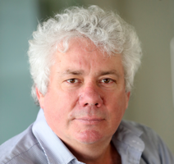
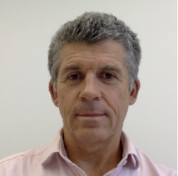
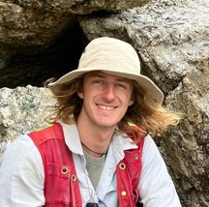
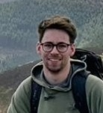
Team
Mike Armitage | PhD geologist with over 30 years’ experience in geology globally. Graduated from Cardiff University, then worked on gold mines in South Africa and Zimbabwe. Former Chairman SRK (UK) the global metals and mining consultancy based in Cardiff. Joint course co-ordinator of MSc in Mineral Resources at Cardiff University. Former Vice President of the Geological Society. Resident in Cardiff since 1990.
Roger Murphy | Born and educated in S Wales. B.Sc. geology Swansea Uni. Early career as an exploration and mine geologist in Africa and elsewhere, much of it gold focused. 25 years as a specialist mining financier in the City of London. Former CEO of AIM-listed mineral exploration companies. Currently CEO of a private African copper explorer.
Tristan English | Graduated with Masters in Geology from Cardiff University in 2021 including one year of international study at the University of Western Australia. Experience in gold and lithium exploration and drilling in Western Australia and the Northern Territory of Australia. Joined Sarn Helen Gold upon completing his studies in 2021 and now acts as project geologist directing and managing fieldwork activities alongside Jasper Thomas.
Jasper Thomas | Graduated with Masters in Geology from Cardiff University in 2021. Expertise and interest in geochemisty. Joined Sarn Helen Gold in the summer of 2021 where his knowledge of geochemistry is now applied to gold exploration. He has also developed a particular interest in the structural geology of gold deposits. Jasper works alongside Tristan English in managing fieldwork activities and carrying out analysis of exploration data.

Slide 6

Significant Progress
Raise £200,000 to fund 2023
Raise company profile, launch website
Commence exploration in Peeblesshire
Trench gold target near Dolaucothi
Follow up work in Carms and Pembs, both regionally and developing existing targets
Engage with National Trust to obtain access to a large parcel of land not yet granted
Aiming to have drill ready targets for 2024
Raised £244,500 from HNW investors
Employed 2 full time geologists
Established and maintained constructive relationships with local farmers
First field season in Pembs using 6 Cardiff University students on placement (despite Covid)
Located new targets for follow up
2020
2021
2022
2023
Incorporated Nov 2019
Founders invested £40,000 in seed finance
Acquired four gold exploration licences in Pembs. and Carms.
Desk research and compilation of historic data
Received EIS approval from HMRC
Raised £186,000 from HNW investors
Acquired Dolaucothi Licence
Acquired all historic Dolaucothi exploration data from multiple sources
Field seasons in both counties
Identified targets for further work
Located gold anomalies at Dolaucothi away from the mine
Acquired Peeblesshire exploration licence in the Southern Uplands of Scotland

Slide 7
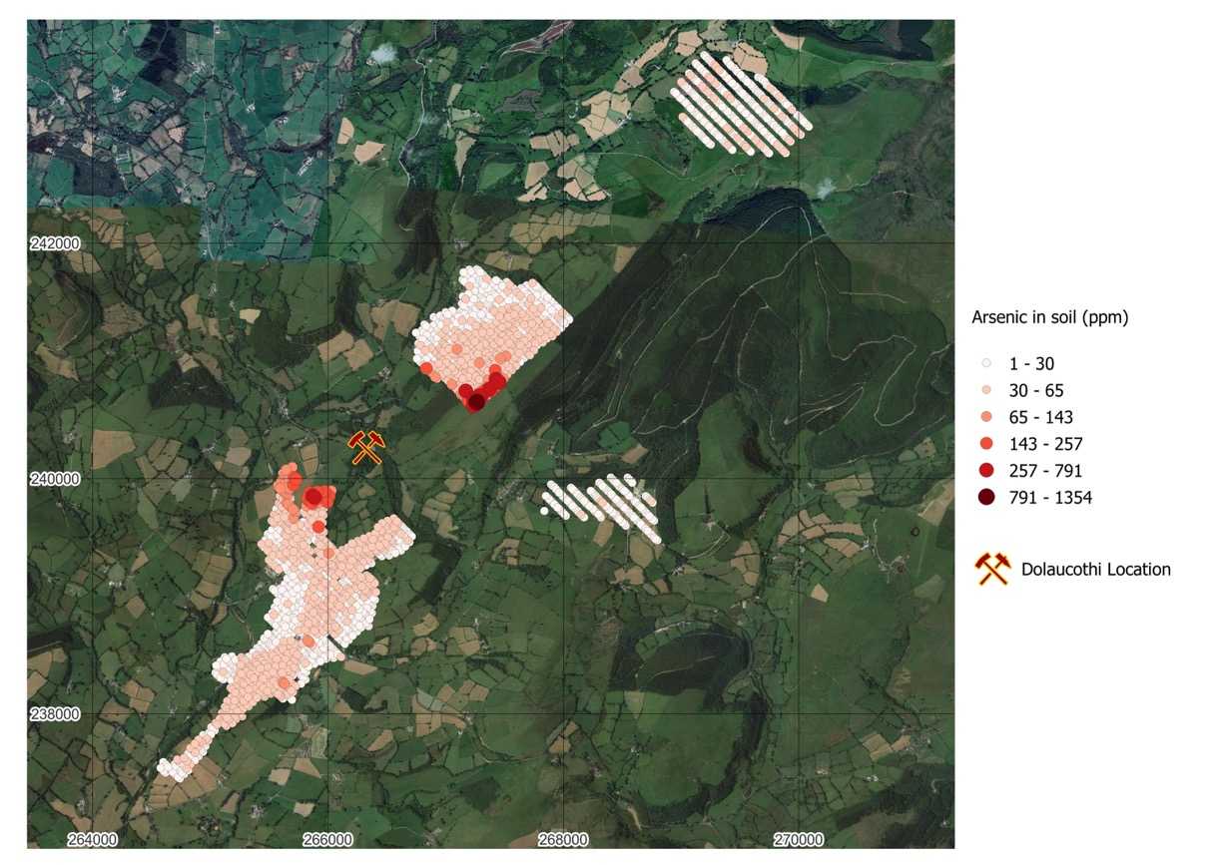
Dolaucothi Area Field Activity
Licence area 250 km²
Work to date focused around the Dolaucothi Mine. Specifically, so far we have collected:
  2,746 soil samples
  23 stream sediment samples
  57 rock chip samples
  15 panned concentrates and recovered 83 gold grains.
We have also undertaken geological mapping of the Dolaucothi area to assist in the development of our 3D geological model of the area.

Slide 8
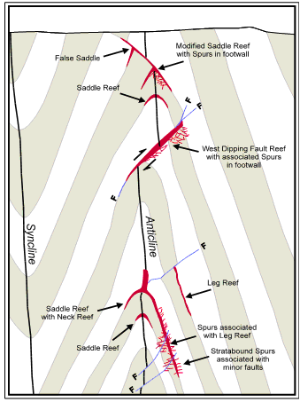
Dolaucothi: Potential for multiple targets
Mineralisation styles at Dolaucothi show similarities to the prolific Bendigo district of Australia, shown to host numerous distinct gold bearing reefs - we use the model on the right to explore around Dolaucothi
Developed detailed 3D model of controls on gold mineralisation at Dolaucothi
Located historic boreholes containing gold mineralisation drilled near Dolaucothi at British Geological Survey depot
Soil sampling in 2022 has identified gold occurrences in area not derived from Dolaucothi mine
Planning trenching during summer 2023 to expose potential gold mineralisation at Brunant away from mine.
Generate targets to drill in 2024

Slide 9
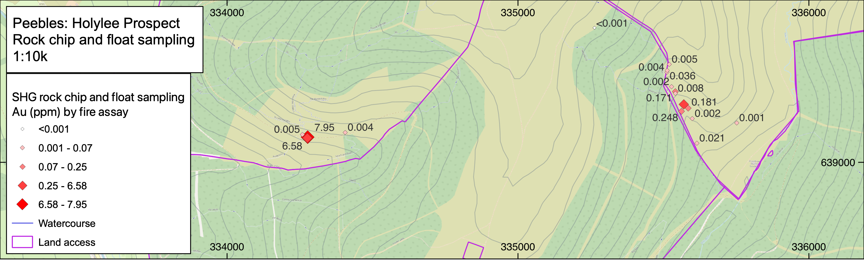
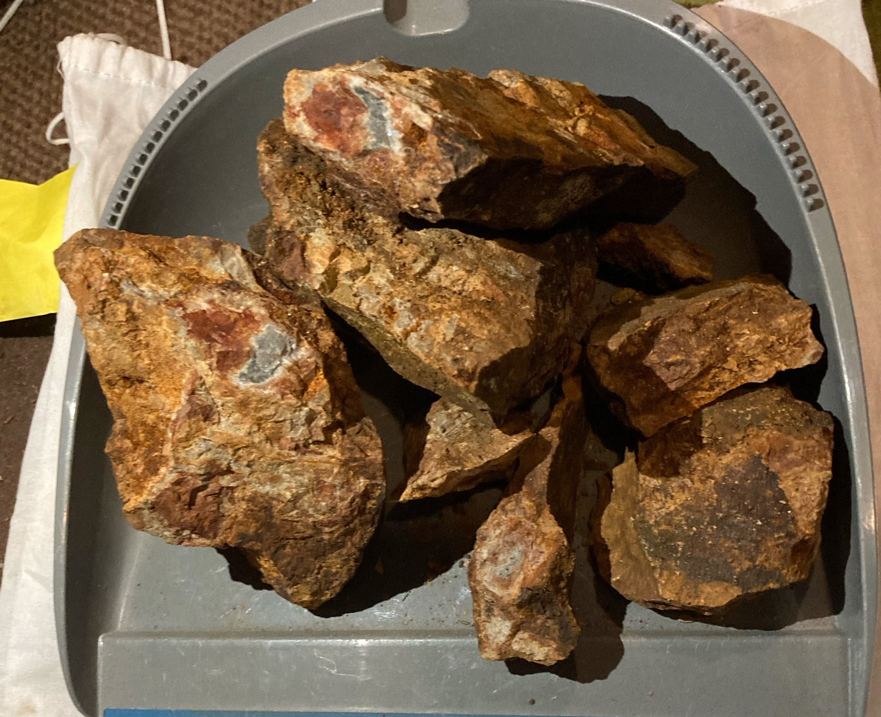
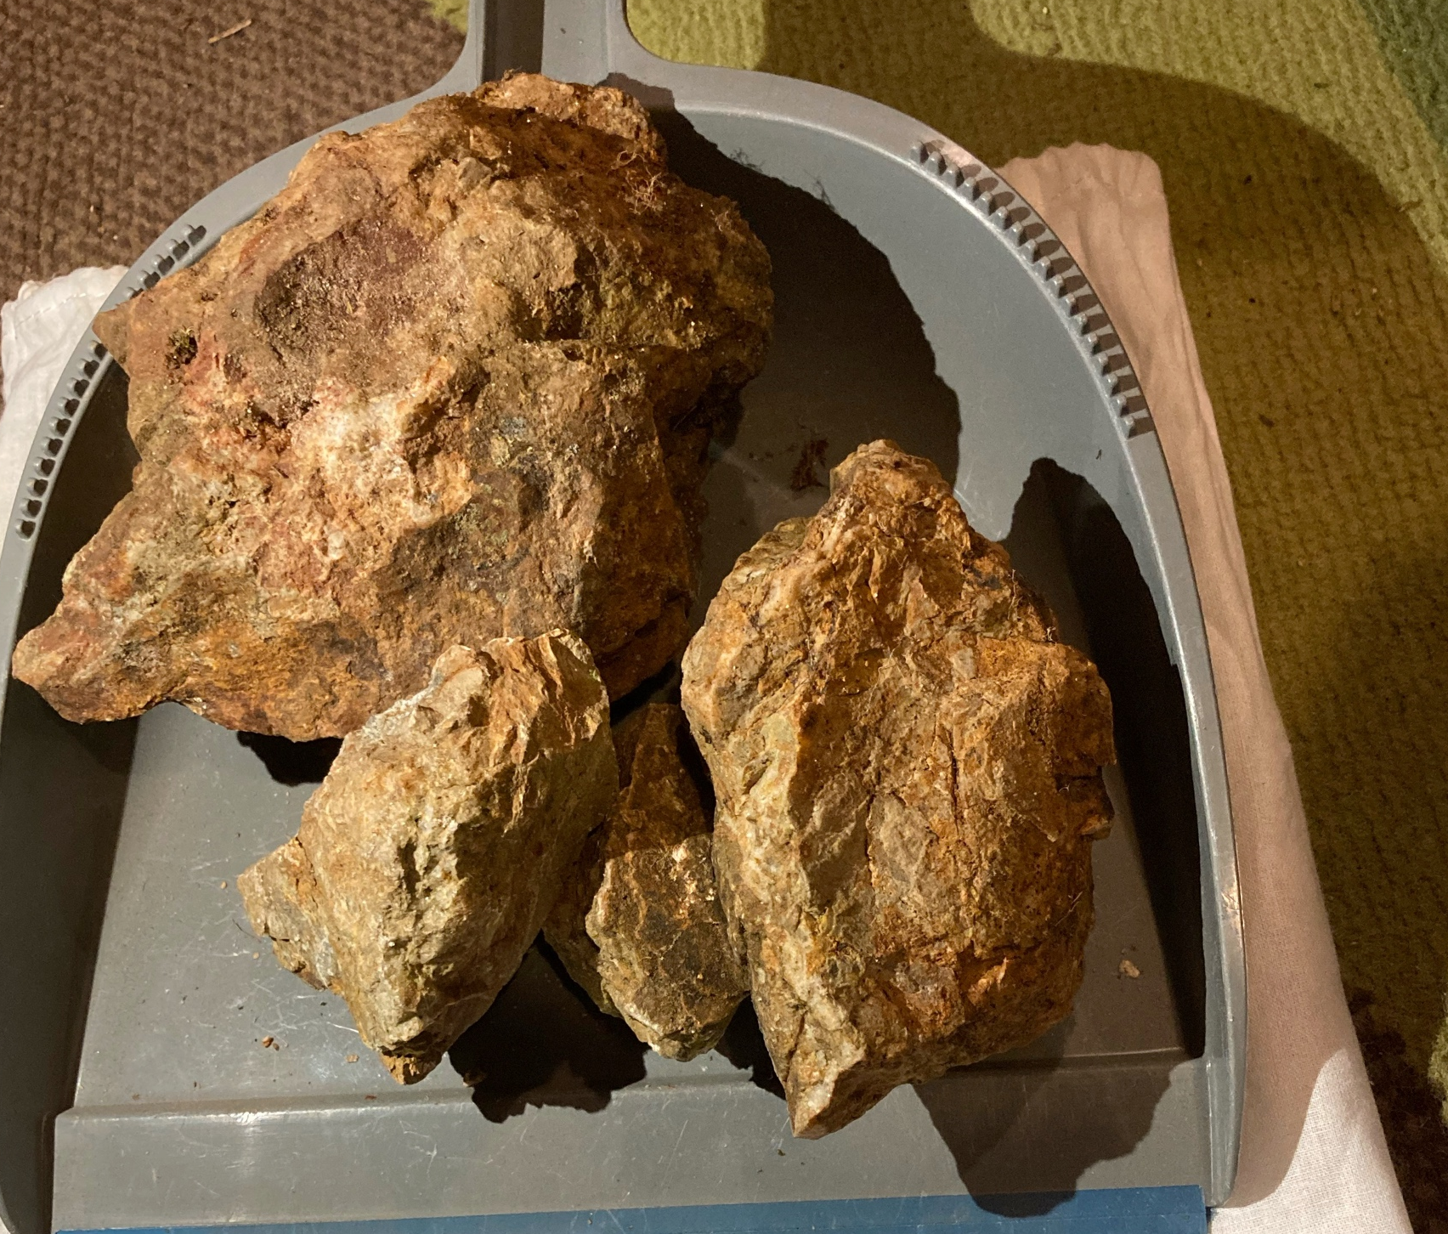
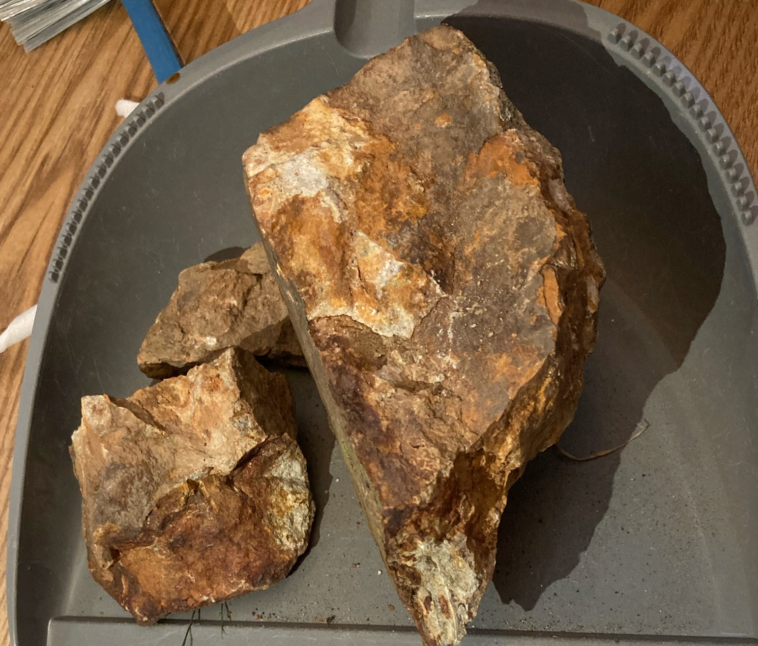
Peeblesshire: Encouraging initial field season
First field season during Easter 2023 at the Holylee prospect on our newly acquired Peeblesshire exploration licence discovered very encouraging economic gold grades in rock chip float samples. Stream sediment survey results are expected soon.
Rock chip float samples assaying at up to 7.95 g/t Au on the Holylee prospect.
Awaiting lab results from our stream sediment survey of the Holylee prospect.
Stream sediment sampling and rock chipping programme planned for a second prospect in the licence area (Stobb Law) during summer 2023.
7.95 g/t Au
6.58 g/t Au
1.37 g/t Au

Slide 10
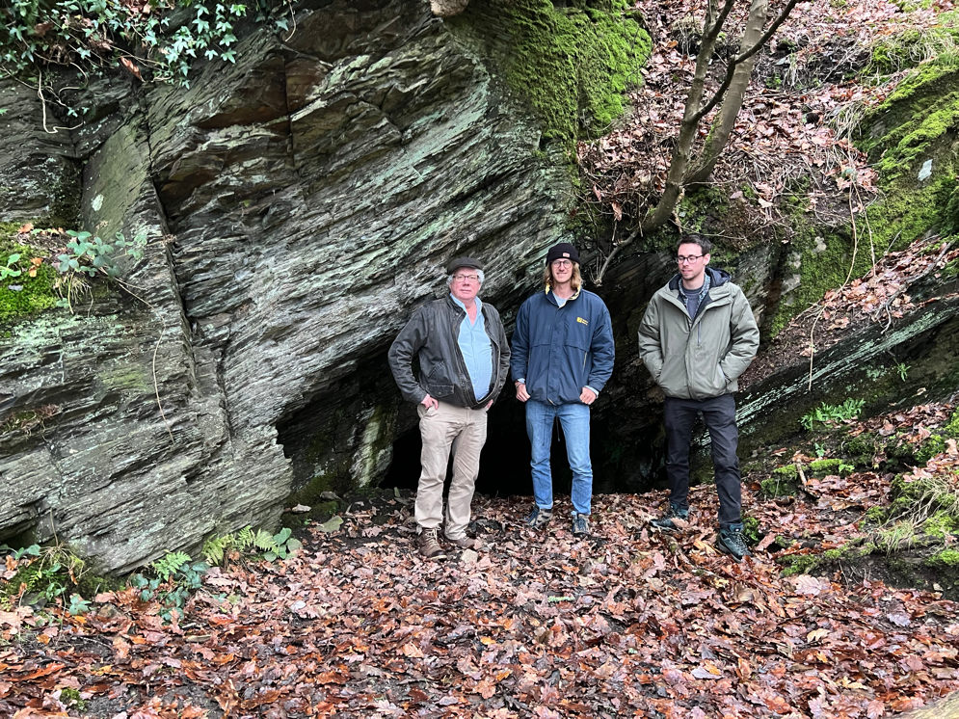
Commercial Strategy
Remain private in the short to medium term.
Raise profile of company through careful communication with local community, local and national (Welsh) Government authorities, investors, press etc.
Strong local and community engagement central to SHG
Determine best time to go public based on exploration results, funding requirements, value added and market sentiment.

Slide 11
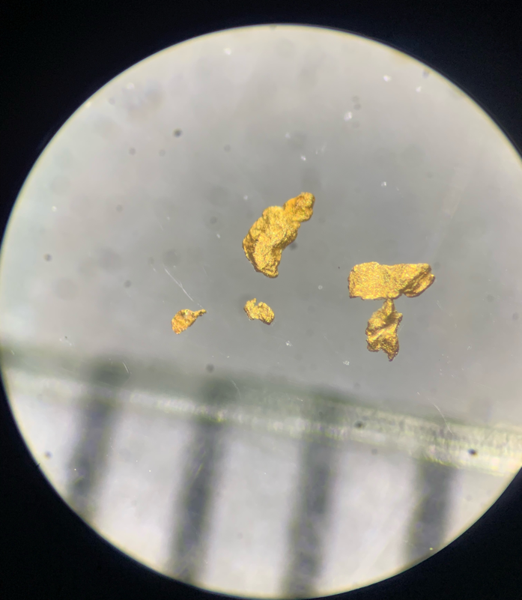
Investment Opportunity
Looking to raise c. £150,000 - £200,000 to complete 2023 exploration plans
Minimum investment size £1,000
Offering shares at £1.50/sh which values SHG at £1.6mn
Expecting larger raise at higher price late in 2023 to fund a drilling programme around Dolaucothi
Full EIS relief available to all UK tax-payers

Slide 12
Capital Structure
Shares Outstanding Employee Options Valuation/share Valuation Proposed raise Post raise shares outstanding | 1,074,150 61,540 £1.50 £1,611,225 £200,000 1,208,150
Current shareholders over 5%:
Iestyn Humphreys (Non Executive Director) | 15.30%
Mike Armitage (Managing Director & Founder) | 15.05%
Roger Murphy (Executive Director & Founder) | 14.01%
Alex Mikhailov (Founder) | 9.36%
David Pearn (Non Executive Director) | 6.42%

Slide 13
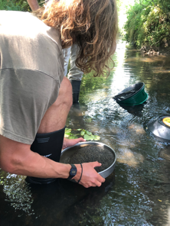
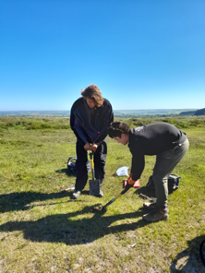
The Life Cycle of a Mining Project
$
Mine Construction
Life of Mine (LOM)
Production scheduling.
Production
Risk
Trial Processing
Are the recoveries and purity what I expected?
I am now making money!
Investment Confidence & Accuracy
Finance
Local or international? Is everything compliant to an international reporting code?
Value of Company
LOM Extension
Feasibility Study
Detailed analysis of optimal mining methods and costing using suppliers quotes.
Can I make it last longer?
Pre-Feasibility Study
Modelling the operation and optimising the mining method and processing equipment.
Closure and Rehabilitation
Current SHG status
$
Scoping Study
Identify how to get it out, how much it will cost and what is it worth?
Mineral Resource Estimate (MRE)
How much have I got? Are the elephants big enough?
Did I leave it better than before?
Exploration
Licence
Idea

Slide 14
Use of Funds
Description | £
Soil sampling, steam sediment sampling, mapping, satellite imagery, historical core sampling, trenching and geophysical surveys over areas of interest. | 90,000
Sample analysis (XRF & gold assay) | 30,000
Renewal of Option Agreements | 35,000
Consultants/Advisors | 20,000
Community Fund | 5,000
Contingency | 20,000
Total | 200,000
➔ SHG board have not and do not plan to draw any salaries, but are awarded options at the current offer price to compensate for work undertaken

